Slide 1
Question #1
A professor decides to make his class notes available online. At the end of the quarter, several students mention in the course evaluation that having notes readily available helped them to do well in class. This is an example of:
A) Observational Study
B) An Experiment
C) Neither

Slide 2
Question #2
Researchers in Britain randomly divide a large number of preterm babies into three groups. One received donated breast milk, one received infant formula made for preterm babies, and the third received regular infant formula. Each diet was used for one month as a sole food or as a supplement to mother’s milk. Sixteen years later, the children returned and had their blood pressure measured. It was found that diastolic and systolic blood pressure both tended to be lower in the children who were fed breast milk than in the children who were fed formula. This study is an example of:
A) An experiment
B) An Observational study
C) Census

Slide 3
Question #3
Suppose you would like to determine which age groups in the U.S. (18-29, 30-49, 50-64, or 65 or older) currently identify watching television as their favourite way to spend an evening. The most appropriate statistical study to answer this question would be:
A) A survey
B) An observational study this is not a survey
C) An experiment

Slide 4
Question #4
A zoologist studying adult bears measures a number of different variables. Which of the following possible variables is categorical?
A) The weight in pounds of an adult bear
B) The level of aggression (low, moderate, high) displayed by an adult bear
C) The number of fish an adult bear eats in a particular day.

Slide 5
Question #5
When ordering vinyl replacement windows, the following variables are specified for each window. Which of these variables is quantitative?
A) Window style – double-hung, casement, or awning
B) Area of the window opening in square inches
C) Window style- single-pane or double-pane

Slide 6
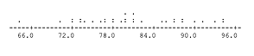
Question #6
A professor gave a statistics final to 32 students. Following is a dotplot of the results.
What percentage of students scored above 90?
A) 15.6%
B) 84.4%
C) 12.5%

Slide 7
Question #7
A professor gave a statistics final to 32 students. A dotplot of the result follows.
The center of this distribution is located at approximately
A) 72.5
B) 87.5
C) 80.5

Slide 8
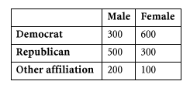
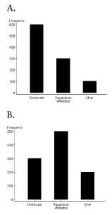
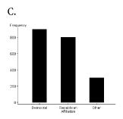
Question #8
A review of voter registration records in a small town yielded the following table of the number of males and females registered as Democrat, Republican, or some other party affiliation.
Which of the following bar graphs represents the distribution of party affiliation among all voters in this town?

Slide 9
Question #9
Which of the following studies would be considered an example of statistical inference?
A) Before this season’s Super Bowl, a newspaper prints a bar graph displaying the distribution of past Super Bowl Most Valuable Players by position.
B) A study involving a large number of heart bypass patients found that the patients who took vitamin E supplements for several weeks prior to their operation had significantly better heart function after the procedure than the patients who took placebo (sham) supplements.
C) A news magazine tabulates the number of auto accidents, number of related injuries, and number of related fatalities in each year from 1995 to 2005.

Slide 10
Question #10
A researcher wants to study the effect of regular exercise on cholesterol level. The researcher compares the cholesterol levels of 50 people who belong to a local gym and exercise their regularly with the cholesterol levels of 50 people from the same community who do not exercise regularly. The cholesterol levels of the gym members are substantially lower. The researcher can conclude that
A) Belonging to a gym reduces cholesterol level
B) Exercising regularly at a gym reduces cholesterol level
C) Members of a local gym who exercise their regularly have lower cholesterol levels than people in the community who do not exercise regularly

Slide 11
Researchers in Britain randomly divide a large number of preterm babies into three groups. One received donated breast milk, one received infant formula made for preterm babies, and the third received regular infant formula. Each diet was used for one month as a sole food or as a supplement to mother’s milk. Sixteen years later, the children returned and had their blood pressure measured. It was found that diastolic and systolic blood pressure both tended to be lower in the children who were fed breast milk than in the children who were fed formula. This study is an example of:
A) An experiment
B) An Observational study
C) Census

